Slide 1


2024 Results
Sustainability Strategy & Targets

Slide 2


Content
1
Context and Sustainability macro-trends in our industry
2
Climate: fast forwarding our transition to Science Based Net Zero
3
Product: pioneering sustainability of Global High Value Tyre
ACTION PILLARS
4
Nature: redefining business interactions with Natural Capital
5
People: at the heart of our growth
6
Strengthening our Global Value Chains
7
ESG Indexes & Ratings: performance

Slide 3





Our commitment
CONTEXT
Lead a value chain creating a positive impact on People, Planet and Mobility, with ambitious Plans supported by Technology, Innovation and data driven Actions, setting challenging Targets fully embedded in day-to-day management and constantly checked for progress.
REDUCING
CLIMATE
IMPACT
-57%
CO2 emission scope 1+2
today vs 2018
RESPECT AND CONSERVATION OF NATURE
PEOPLE
AT THE HEART
OF GROWTH
First tyre
with FSC™
-certified natural
rubber
(launched in 2021)
NET ZERO 2040
>70%
Bio-based and
Recycled materials
on best product ¹
<1
Accident frequency index² by 2030
>80%
Bio-based and
Recycled materials
by 2030¹
-60%
Water withdrawal by 2030
vs 2015
CREATING SUSTAINABLE PRODUCTS
>33%
Woman in management within 2030
FY2024 figures; 1. P-Zero developed for JLR 2. Frequency Index(FI): Σ( Fatalities + Serious lost time injuries + Lost time injuries ) x 1.000.000/ worked hours; If calculated based on 200.000 hours worked, Index 2024 is 0,28, ~ 0,2 @2025 and <0,2 @2030.

Slide 4

Reducing Climate Impact
The most ambitious decarbonization plan of the industry

Slide 5
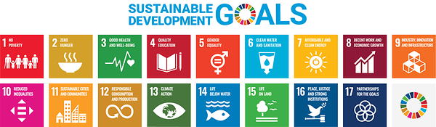




Fast forwarding our Transition: commitments to reach Net Zero by 2040
CLIMATE
New Targets approved by SBTI¹, after having reached previous ones 2 years in advance²
2030 Carbon Neutrality on scope 1+2 emissions; strong emission abatement managed
in alignment with ISO 14068
SCOPE 3
SUPPLIER EMISSIONS
SCOPE 1+2
OWN EMISSIONS
-25%¹
2040 NET ZERO on scope 1+2+3 emissions, aligned with Paris agreement
(1.5° pathway)
-28%
-30%¹
-45%¹
The most ambitious decarbonization plan of the industry
-62%
-80%¹
≥-90%¹
1.5° aligned
2018
2023
2027
2030
2040
Baseline year
Carbon
Neutrality²
Net
Zero
Scope 1+2
Scope 1+2+3
Near-Term and Net-Zero SBTi Targets approved for Scope 1+2+3
Claim in line with ISO 14068 standard for scope 1+2

Slide 6
Meeting our climate goals: How and When
CLIMATE
Increasing availability of primary data on total emissions (already >90% in 2024)
SUPPLIER DECARBONIZATION PROGRAM
REMOVAL²
>90% Scope 3 upstream emissions with available primary data and 100% requested to set SBTi targets by 2025
> 40% Bio-based and Recycled materials by 2030⁴
> 80% Bio-based and Recycled materials by 2040⁴
SCOPE 3
SUPPLIER EMISSIONS
RENEWABLE ELECTRICITY
OFFSET²
100% Renewable Electricity by 2025, relying on proven market tools and additionalities
SCOPE 1+2
OWN EMISSIONS
ENERGY EFFICIENCY
ELECT FACTORY
90+ Energy efficiency projects with 50Mln € Capex 2022-25
75%¹ of curing presses electrified by 2030 with 22 mln €/year Capex 2024-30
and +80% energy efficiency
1,5° aligned
2018
2023
2025
2030
2040
Baseline year
Carbon
Neutrality³
Net
Zero
Scope 1+2
Scope 1+2+3
1. 100% in Europe 2. Compensation of unavoidable emissions through verified and additionality-related projects available at the relevant timing; 3. In alignment with ISO 14068; 4. On total production

Slide 7
Focus on Scope 3: supply chain decarbonization strategy
CLIMATE
Pirelli total absolute emissions
Action on raw material suppliers
(GHG Protocol and SBTi aligned)
(Responsible for 90% of scope 3¹)
~3,478
~3,347
Increasing availability of primary data on total emissions (already >90% in 2024²)
Suppliers engagement in targets:
100% requested to set SBTi
Targets by 2025
100% requested to use only Renewable Electricity attributed to Pirelli supplies by 2025
ktCO₂e
ktCO₂e
TARGETS vs 2018
2030
2040
-30%
-90%
Scope 3
89%
vs 86% FY23
Increasing local-for-local sourcing, reducing logistics emission
Raw Materials switch to bio-based and recycled, targeting >40% of total production by 2030 and >80% by 2040
11%
vs 14% FY23
Scope 1+2
2023
2024
1. Upstream Emissions; 2. referred to total upstream emissions

Slide 8

Creating Sustainable Products
Designed for EV mobility, towards 100% materials of non-fossil origin, enabling our customers’ decarbonization journey

Slide 9

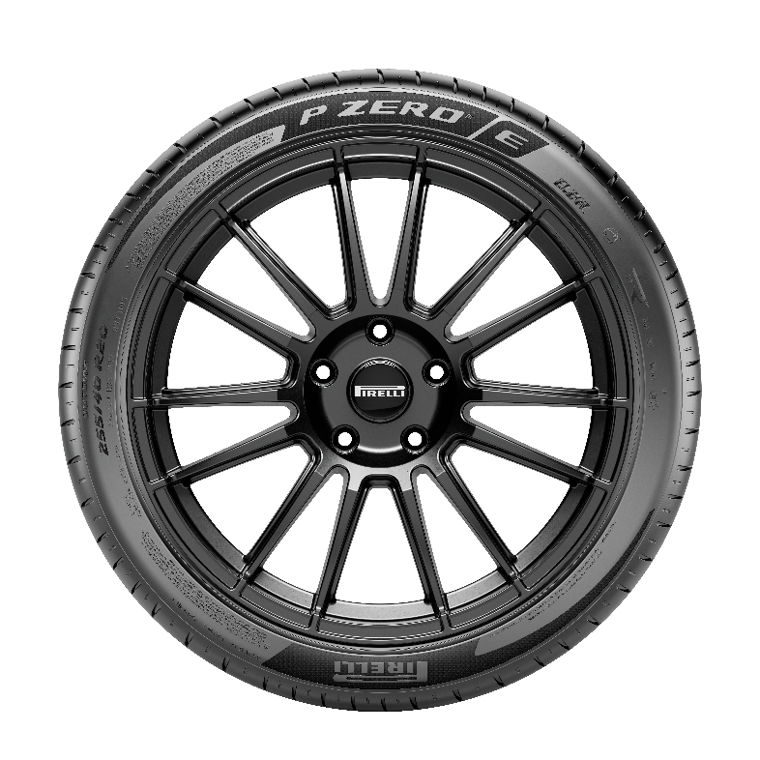

New PZERO E: our lighthouse on the market
PRODUCT
Pioneering sustainability of the High Value segment: pushing the limits of sustainable design key drivers
Less fossil materials
Reduced vehicle CO₂ emission
>58,5% Bio-based and Recycled
materials¹
Validated by third party²
AAA³ European Label
Designed for new EV mobility
Low wear rate
-42% wear rate vs previous product,
as certified by Dekra
1. Thanks to a combination of physical segregation and mass balance approach. Depending on tyre size, bio-based and recycled content ranges between 27-32% and 23-28% respectively. Bio-based materials are natural rubber, textile reinforcements and bio-chemicals, while recycled materials are – through mass balance – synthetic rubber and silica. (ISO 14021). 2. Bureau Veritas 3. Triple A means that the tyre outperforms in terms of Rolling Resistance, Wet Grip and Noise, according to European tyre Label A.

Slide 10



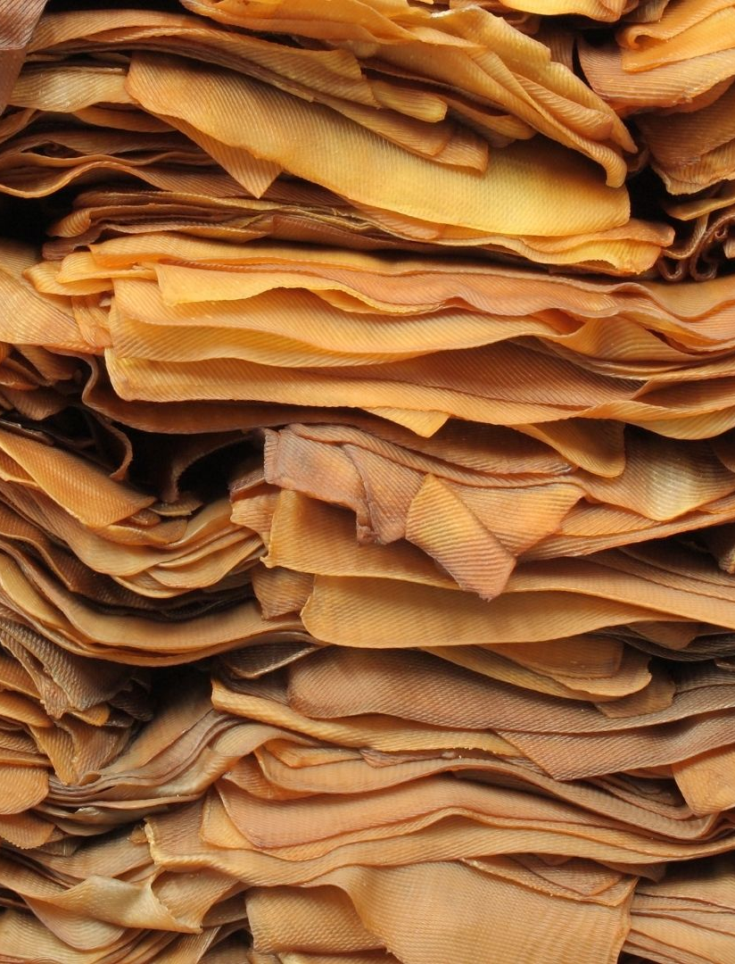



Materials | Towards 100% of non-fossil origin, third-party certified
PRODUCT
Targets
% of bio-based and recycled materials in weight
TOWARDS 100%
NON-FOSSIL ORIGIN
>80%
We push innovation to increase bio-based and recycled materials while decreasing fossil ones
>70%
BEST PRODUCT¹
58,5%
>55%
Old 2025 target: 43%
Transparency for consumers: New Pirelli logo identifying tyres with
≥ 50% of bio-based and recycled materials
33%
40%
27%
23,7%
TOTAL PRODUCTION²
21%
23%
Sustainable content certified by third party
2021A
2023
2024A
2025
2030
Old Target @2025 reached in 2023
1. Available on the market; 2. Volume of all raw materials bio-based and recycled vs total raw materials used for all tyre production

Slide 11
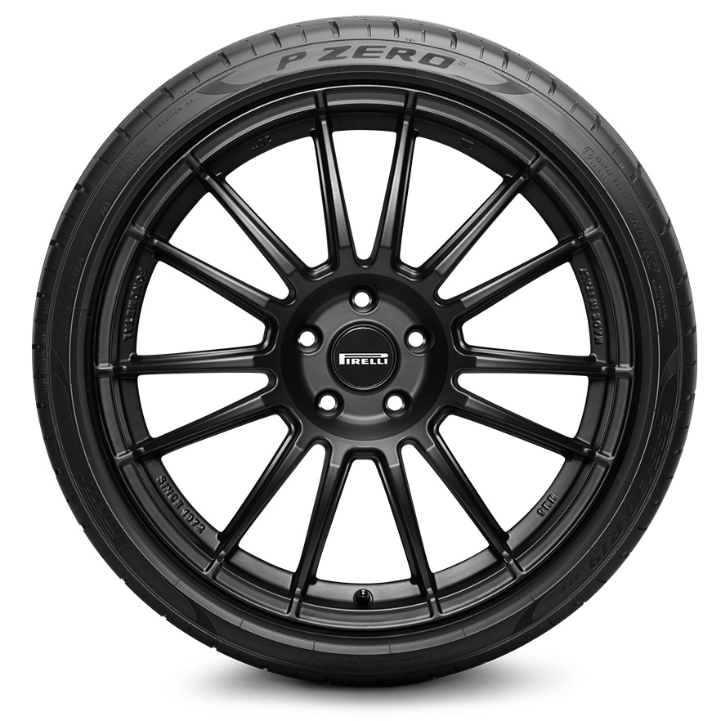


Circularity along our product life-cycle
PRODUCT
Embedding the 5R in product life-cycle
Eco-Safety design
5R
Re-think
Natural
rubber
Refuse
Digital Virtualization
Life-Cycle Assessment
Reduce
Reuse
Sustainable sourcing certified
R&D for biodegradability
Recycle
1
End-of-life
Non fossil
materials certified
Materials recycle
High-tech recovered
Carbon Black
100%
SUSTAINABLE
TYRE
5
2
Bio-based
Recycled
Low emissions
in use
4
Sustainable
chemistry²
Ultra Low RR
Wear rate reduced
3
No use of SVHC & POPs¹
Alternatives to 6PPD
Sustainability in operations
The Elect Factory
100% renewable electricity
Waste reduction
Low carbon Logistics
1. Per its Policy, Pirelli tyres and rubber compounds are manufactured: without the use of Substances of Very High Concern (SVHC) and without substances covered by Stockholm Convention on Persistent Organic Pollutants (POPs) and by Minamata Convention on Mercury 2| Pirelli applies and supports the technical indications concerning a development model based on a sustainable chemistry provided by the Organisation for Economic Cooperation and Development (OECD) – FSC™ N003618

Slide 12
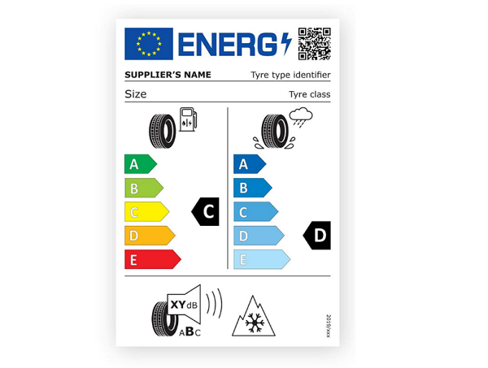
Eco-Safety performance: enabling our customers decarbonization journey
PRODUCT
Expanding offer of low Rolling Resistance tyres, never compromising on safety
Targets
New IPCodes¹
2023
2024
2025
Tyre rolling resistance plays a key role in reducing fuel and energy consumption and thus vehicles CO₂ emissions.
Rolling Resistance
A+B=55%
A+B=55%
A+B>70%
Wet Grip²
A+B=98%
A+B=91%
A+B>90%
Life-Cycle Assessment: 100%
for New Car Lines by 2025
Our Eco-Safety approach consists in a continuous reduction of rolling resistance without any compromise on safety
in all driving conditions.
Eco-Safety Business¹
2023
2024
2025
2030
A+B+C revenues³
73%
73%
66%
A+B volumes⁴
30%
35%
35%
>50%
Target 2025 already reached in 2023
1. Extra EU labelling scales are converted to EU labelling grades; 2. Wet Grip index includes all new IPCodes with WG falling in classes A+B according to EU labelling values and IPCodes with ICE pictogram. 3. percentage of revenues from tyres with Rolling Resistance and Wet Grip belonging to classes A+B+C;; 4. percentage of volume of sold tires with Rolling Resistance and Wet Grip belonging to classes A+B;

Slide 13
Eco-safety performance: enabling our customers decarbonization journey
Expanding offer of low Rolling Resistance tyres, never compromising on safety
Tyre rolling resistance plays a key role in reducing fuel and energy consumption and thus vehicles CO₂ emissions.
Our Eco and Safety approach consists in a continuous reduction of
rolling resistance without any compromise on safety.
LESS CO₂ EMISSION
MORE IMPACT
MORE SAFETY
Eco-Safety Business¹
2024A
>70%
>50%
>90%
2030
Volumes of tyres sold with Rolling Resistance and Wet Grip in classes A+B EU labelling
A+B LABEL
ROLLING
RESISTANCE
35%
A+B
VOLUMES
SOLD
>50%
A+B LABEL
WET GRIP
2030
We want to keep higher than 90% the number of new product we introduce every year on the market, by 2025. We scored in 2024 the 91% for such KPI
We want to keep higher than 70% the number of new product we introduce every year on the market, by 2025. We scored in 2024 the 55% for such KPI
Increasing the share of business done with low emission products from the current 34,5% to more than 50% within 2030
ROLLING RESISTANCE= LESS CO₂ EMISSION
WET GRIP= MORE SAFETY
1. Extra EU labelling scales are converted to EU labelling grades.

Slide 14
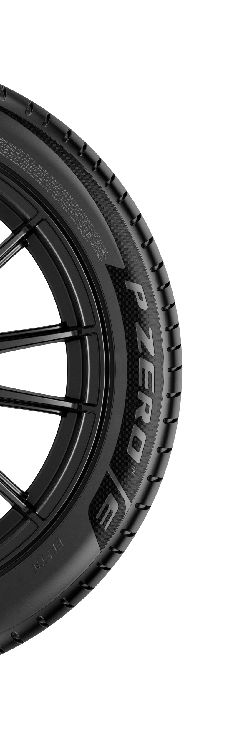


Wear Rate: our reduction roadmap
PRODUCT
Paving the way to anticipate EURO 7 compliance, addressing the higher weight of Electric Vehicles
while improving mileage and consumers’ satisfaction
Targets
Full readiness vs upcoming regulations
New lines
2024
2025
2030¹
-25%
-23%
-30%
EURO 7
Wear Rate
reduction
?
Euro 7 establishes updated rules for the exhaust gas emissions of road vehicles, tyre abrasion and brakes.
Average Wear Rate improvement vs previous reference product line (%) for line introduced in the years:
2023-2024
2023-2025
2025-2030
WHAT IS
Additional Pirelli focus
Tyre abrasion limits will be mandatory from 2028-2030 depending on tyres classes.
TIMING
Particulate size
Material composition
1. Targets and methodology subject to change once official UNECE test method for abrasion in real driving condition is approved; expected 2027 for Car and 2029 for light truck

Slide 15

Nature
Redefining business interactions
with Natural Capital

Slide 16






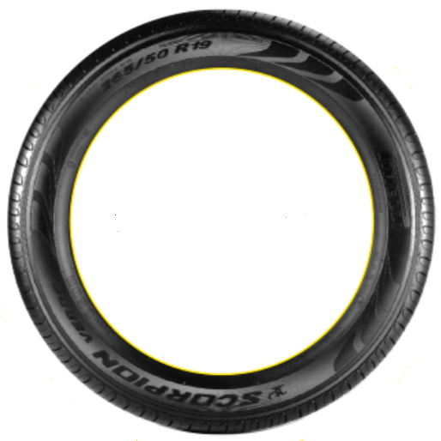



Our Global Biodiversity Strategy along value chain
NATURE
Redefining business interactions with Nature
In line with new Global Standards, towards Science Based Targets for Nature (SBTN)
All Life Cycle Assessments (LCAs) for new product lines include Biodiversity metrics on value chain impacts
100%
in 2024
BIODIVERSITY ACTION PLANS deal with the five IPBES² Drivers of Biodiversity loss and Ecosystems degradation
Land / water / sea use change
Resources exploitation
All Pirelli Industrial sites
and track test areas have
a Biodiversity Action Plan
100%
@2025
55% @2024
RESTORE & REGENERATE
    based on LEAP¹ approach
    dealing the five IPBES² Drivers
REDUCE
Climate change
AVOID
Pollution
2025: TNFD³ Reporting
Preparing for SBTN⁴ aligned targets
Invasive species
1, Locate, Evaluate, Assess and Prepare (LEAP); 2. Intergovernmental Science-Policy Platform on Biodiversity and Ecosystem Services (IPBES); 3. Taskforce for Nature-related Financial Disclosures (TNFD); :4 The Science Based Targets Network (SBTN).

Slide 17



Freshwater: reducing dependency and preserving quality
NATURE
Our Model and Targets according to Excellence in Water Management Program
1
2
3
4
5
Water risks assessment
Minimize water demand
Ensure safe water
and its quality
Clean water back
to ecosystems
Digitalization
Assessment of business and environ. water-related risks;
Definition of mitigation plan
Reduction of water dependency and freshwater consumption: priority in High Water Stress Areas
Promotion of safe water, sanitation and hygiene (as per Internat. best practices)
Replenish water ecosystem with water at equal or better conditions
Complete water networks mapping, Smart metering,
Integration with BEMS¹
Targets
2023
Reduction vs 2015
m³/ton FP²
2024
2025
2030
Group
7.0
-51%
-43%
-60%
QUANTITY
Specific water
withdrawal
yoy – 11%
High Water
Stress Areas
5.4
-35%
-36%
-45%
yoy -5,5%
QUALITY
Water emissions
Group
Preserving water quality
Towards maximization of water reuse and recycling
Previous Plan Target @2025 outperformed in 2023
1. BEMS: Building Energy Management System; 2. Finished Product

Slide 18


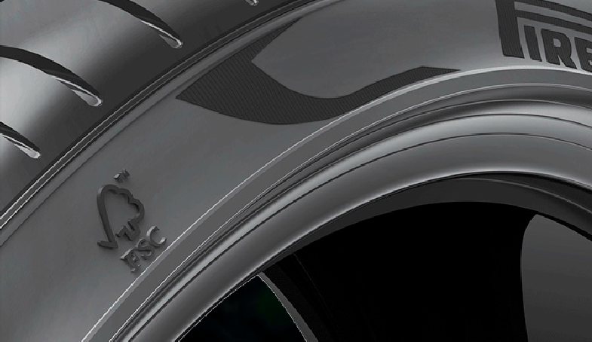
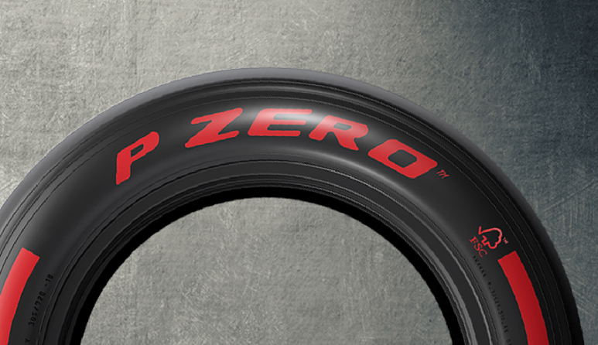
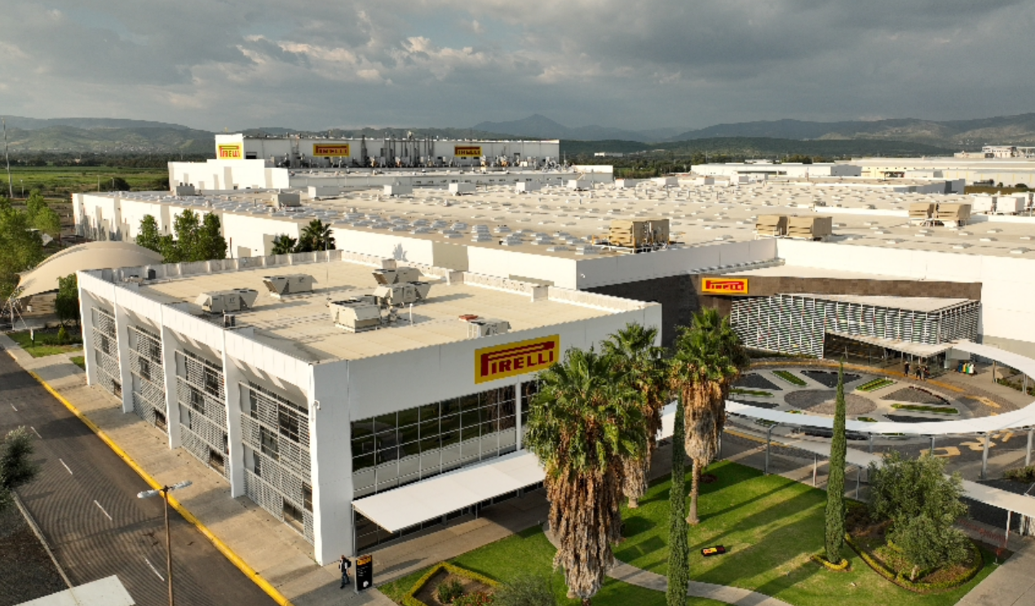
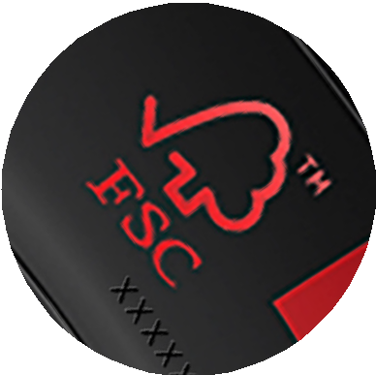

Forest: Towards 100% of FSC™-certified Natural Rubber in European plants by 2026
NATURE
We promote the development of a Sustainable Natural Rubber Economy based on traced
and certified supply chains, engaging our major partners to be part of this journey
Pirelli unique FSC™ strategy
Full readiness vs upcoming regulations
Forest Stewardship Council™ ensures that products from Forest origin are managed in a way that preserves biological diversity and benefits the lives of local people and workers
European Deforestation
Regulation
2021
2024
2026
?
EU rules to guarantee that the products EU citizens consume do not contribute to deforestation or forest degradation worldwide
WHAT IS
Tracing & Due Diligence
- 30 December 2025
TIMING
World first consumer FSC™ certified tyres, made in Rome (Georgia, US) for BMW X5
World first F1® FSC™ certified tyres, from 2024 season
100% FSC™-certified Natural Rubber used in European Pirelli plants
Beef, wood, palm oil, soya, coffee, cocoa. Rubber and derivatives.
SCOPE
FSC™ N003618

Slide 19




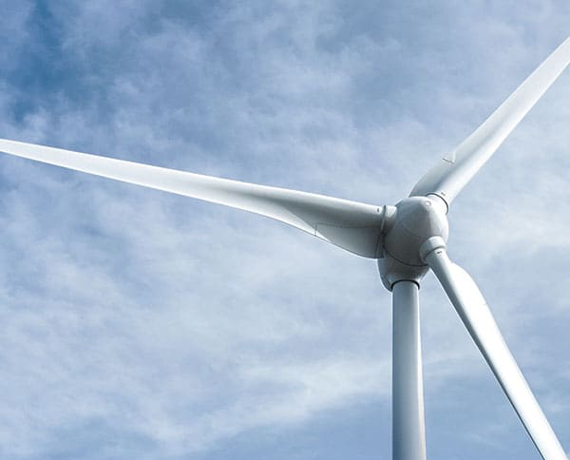
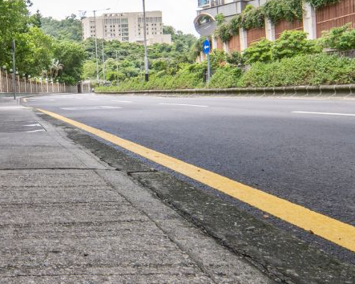

Tyre Road Wear Particles: facing the challenge
NATURE
Context
What is TRWP?
Where does it go²?
How is industry moving?
Mixture of tyre tread fragments and road surface elements generated by the friction between the road and the tyre
Tire Industry Project (TIP)
Soil & Sediments
Potential adverse effects under study
~ 74-77%
CEO-led initiative, proactively working to identify and address potential human health and environmental impacts of TRWP
Water (@ Estuary)
~ 2-5%
Bringing the scientific community together to advance the understanding on tyre unintentional emissions
Key influencing factors: tyre design, road characteristics, driving style, vehicles, weather
Air
~ 2%
TRWP Mitigation task force engaging with relevant stakeholders and guiding mitigation actions through selected pilot projects
Minor contributor of overall PM¹ air pollution
(<1% PM10)
Removal
~ 18%
Our leverage on innovation and engagement
1. Reduction @source
2. Generation & Size
3. Biodegradability
4. Capturing
5. Industry initiatives
-30% wear rate on new product lines by 2030
Cooperation with universities and research centers on airborne particle generation models and means to optimize particle size
Innovation through JDAs and universities on material biodegradability, also through extension of Natural Rubber use
Scouting TRWP capturing solutions, including rainwater collection systems
Active participation in industry initiatives
(TIP and Regional Trade Associations)
1. PM: Particulate Matter; 2. Source: tireparticles.info - infographic

Slide 20

People
At the heart of our growth

Slide 21

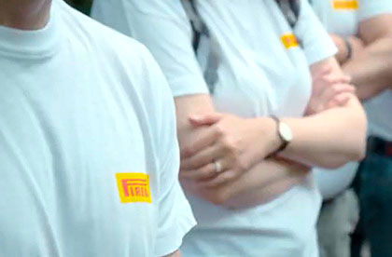



Our strategy for an engaged, diverse and talented global workforce
PEOPLE
We are acting on 5 main pillars
2023
2024
2024 - 2030
SAFETY
FIRST
Towards Zero Accident
at work
1.5¹
-65% vs 2015
1.41¹
~1¹ @2025
<1¹ @2030
Frequency Index
CARING &
WELLBEING
New Pirelli Global Welfare Program
Enhanced welfare offer
Localized offer -
by country
New global offer covering 100% employees @2026
Growing a gender
balanced talents pipeline
Women in
management position
27%
28%
≥33% @2030
DIVERSITY, EQUITY
& INCLUSION
Equality in remuneration
Gender pay gap
+2.7%
in favour of women
+0,4%
in favour of women
±2% @2030
SKILLS
DEVELOPMENT
Upskilling and reskilling focus on digital transformation, excellence in operations, climate science
Average training days
per employee per year
7.4
6.9
Constantly >5.0 days
ENGAGEMENT
& RETENTION
Leveraging on employees listening and experience
Global Sustainable Engagement Index
83%
83%
Constantly ≥80%
1. Frequency Index(FI): ∑( Fatalities + Serious lost time injuries + Lost time injuries ) x 1.000.000/ worked hours; If calculated based on 200.000 hours worked, Index is 0,34 @2023, ~ 0,2 @2025 and <0,2 @2030

Slide 22

Strengthening our
Global Value Chain

Slide 23




Partnering with our suppliers: managing risks while creating capacity
STRENGTHENING OUR GLOBAL VALUE CHAIN
Scope
2023
2024
2025
2027
Suppliers assessed - % on Total Spending from Suppliers selected as potentially High and Mid ESG Risk ⁽³⁾
High ESG Risk⁴
90%
90%
96%
100%
Risk Assessment
& Mitigation
on Environment, Labour, Human Rights, Business Ethics
Mid ESG Risk⁴
82%
82%
96%
100%
ANNUAL RISK ANALISYS
to select potentially High, Mid and Low risk Suppliers
(on all supplier base)
Mandatory recovery plan for non-conformities
Mandatory ESG on-site Audit for all potential suppliers of Raw Materials during Homologation Phase
Continuous effort towards full upstream traceability
Drive excellence in responsible business conduct & mitigate risks
Business and Human Rights Management
100%
of Raw Materials suppliers and CAPEX strategic suppliers
100%
of Raw Materials suppliers and CAPEX strategic suppliers
100%
of High Risk ⁴
^{(all other categories)}
100%
of Mid Risk⁴
^{(all other categories)}
Capacity Building
& Engagement
Nature
& Biodiversity
FSC™
ENGAGEMENT
FSC™
ENGAGEMENT
100%
of Raw Materials suppliers and CAPEX strategic suppliers
TRAINING
Strengthening Partners’ resiliency and accelerate transformation
Raw Material Suppliers accounting for 90% of CO₂ upstream emissions
>90%
Raw Mat Emissions covered by primary
data
>90%
Raw Mat Emissions covered by primary
data
requested to have an SBTi
DECARBONIZATION
Continuous engagement on primary data collection and CO₂ emission reduction initiatives"
requested to use 100% renewable electricity
SBTi: Science-Based Target Initiative; 2. Life Cycle Assessment by RM type and production site; 3. Supplier Risk Assessment performed by Ecovadis and/or Bureau Veritas; 4. Risk Assessment & materiality Approach (Spend > 100k€/y); 5. 100% Raw Mat Suppliers & Capex - Strategic Suppliers

Slide 24





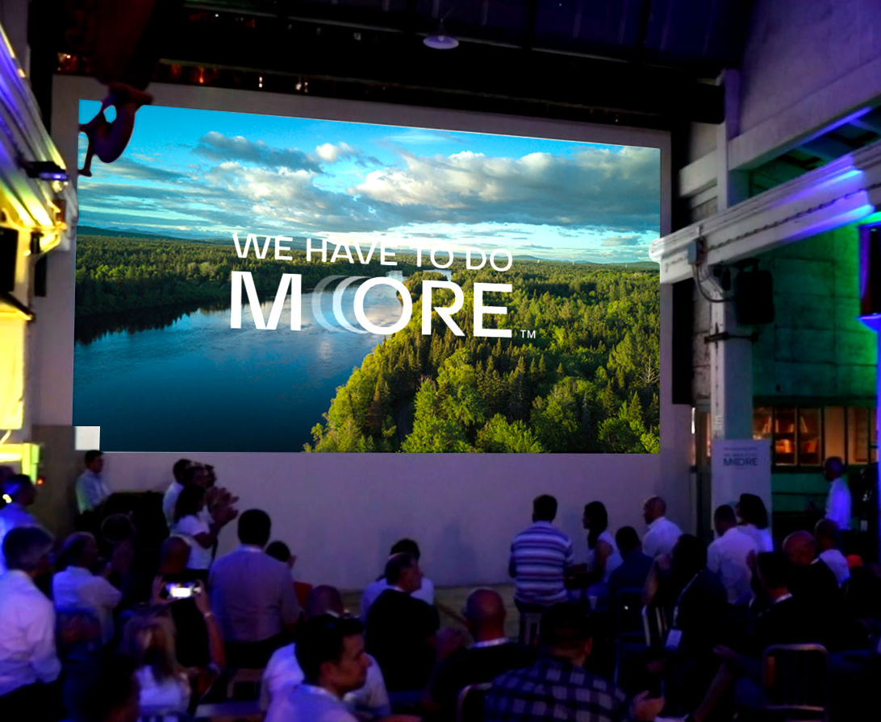
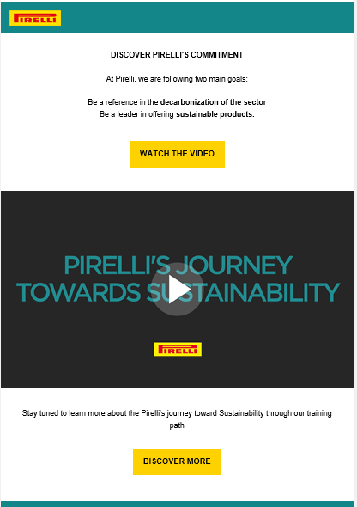
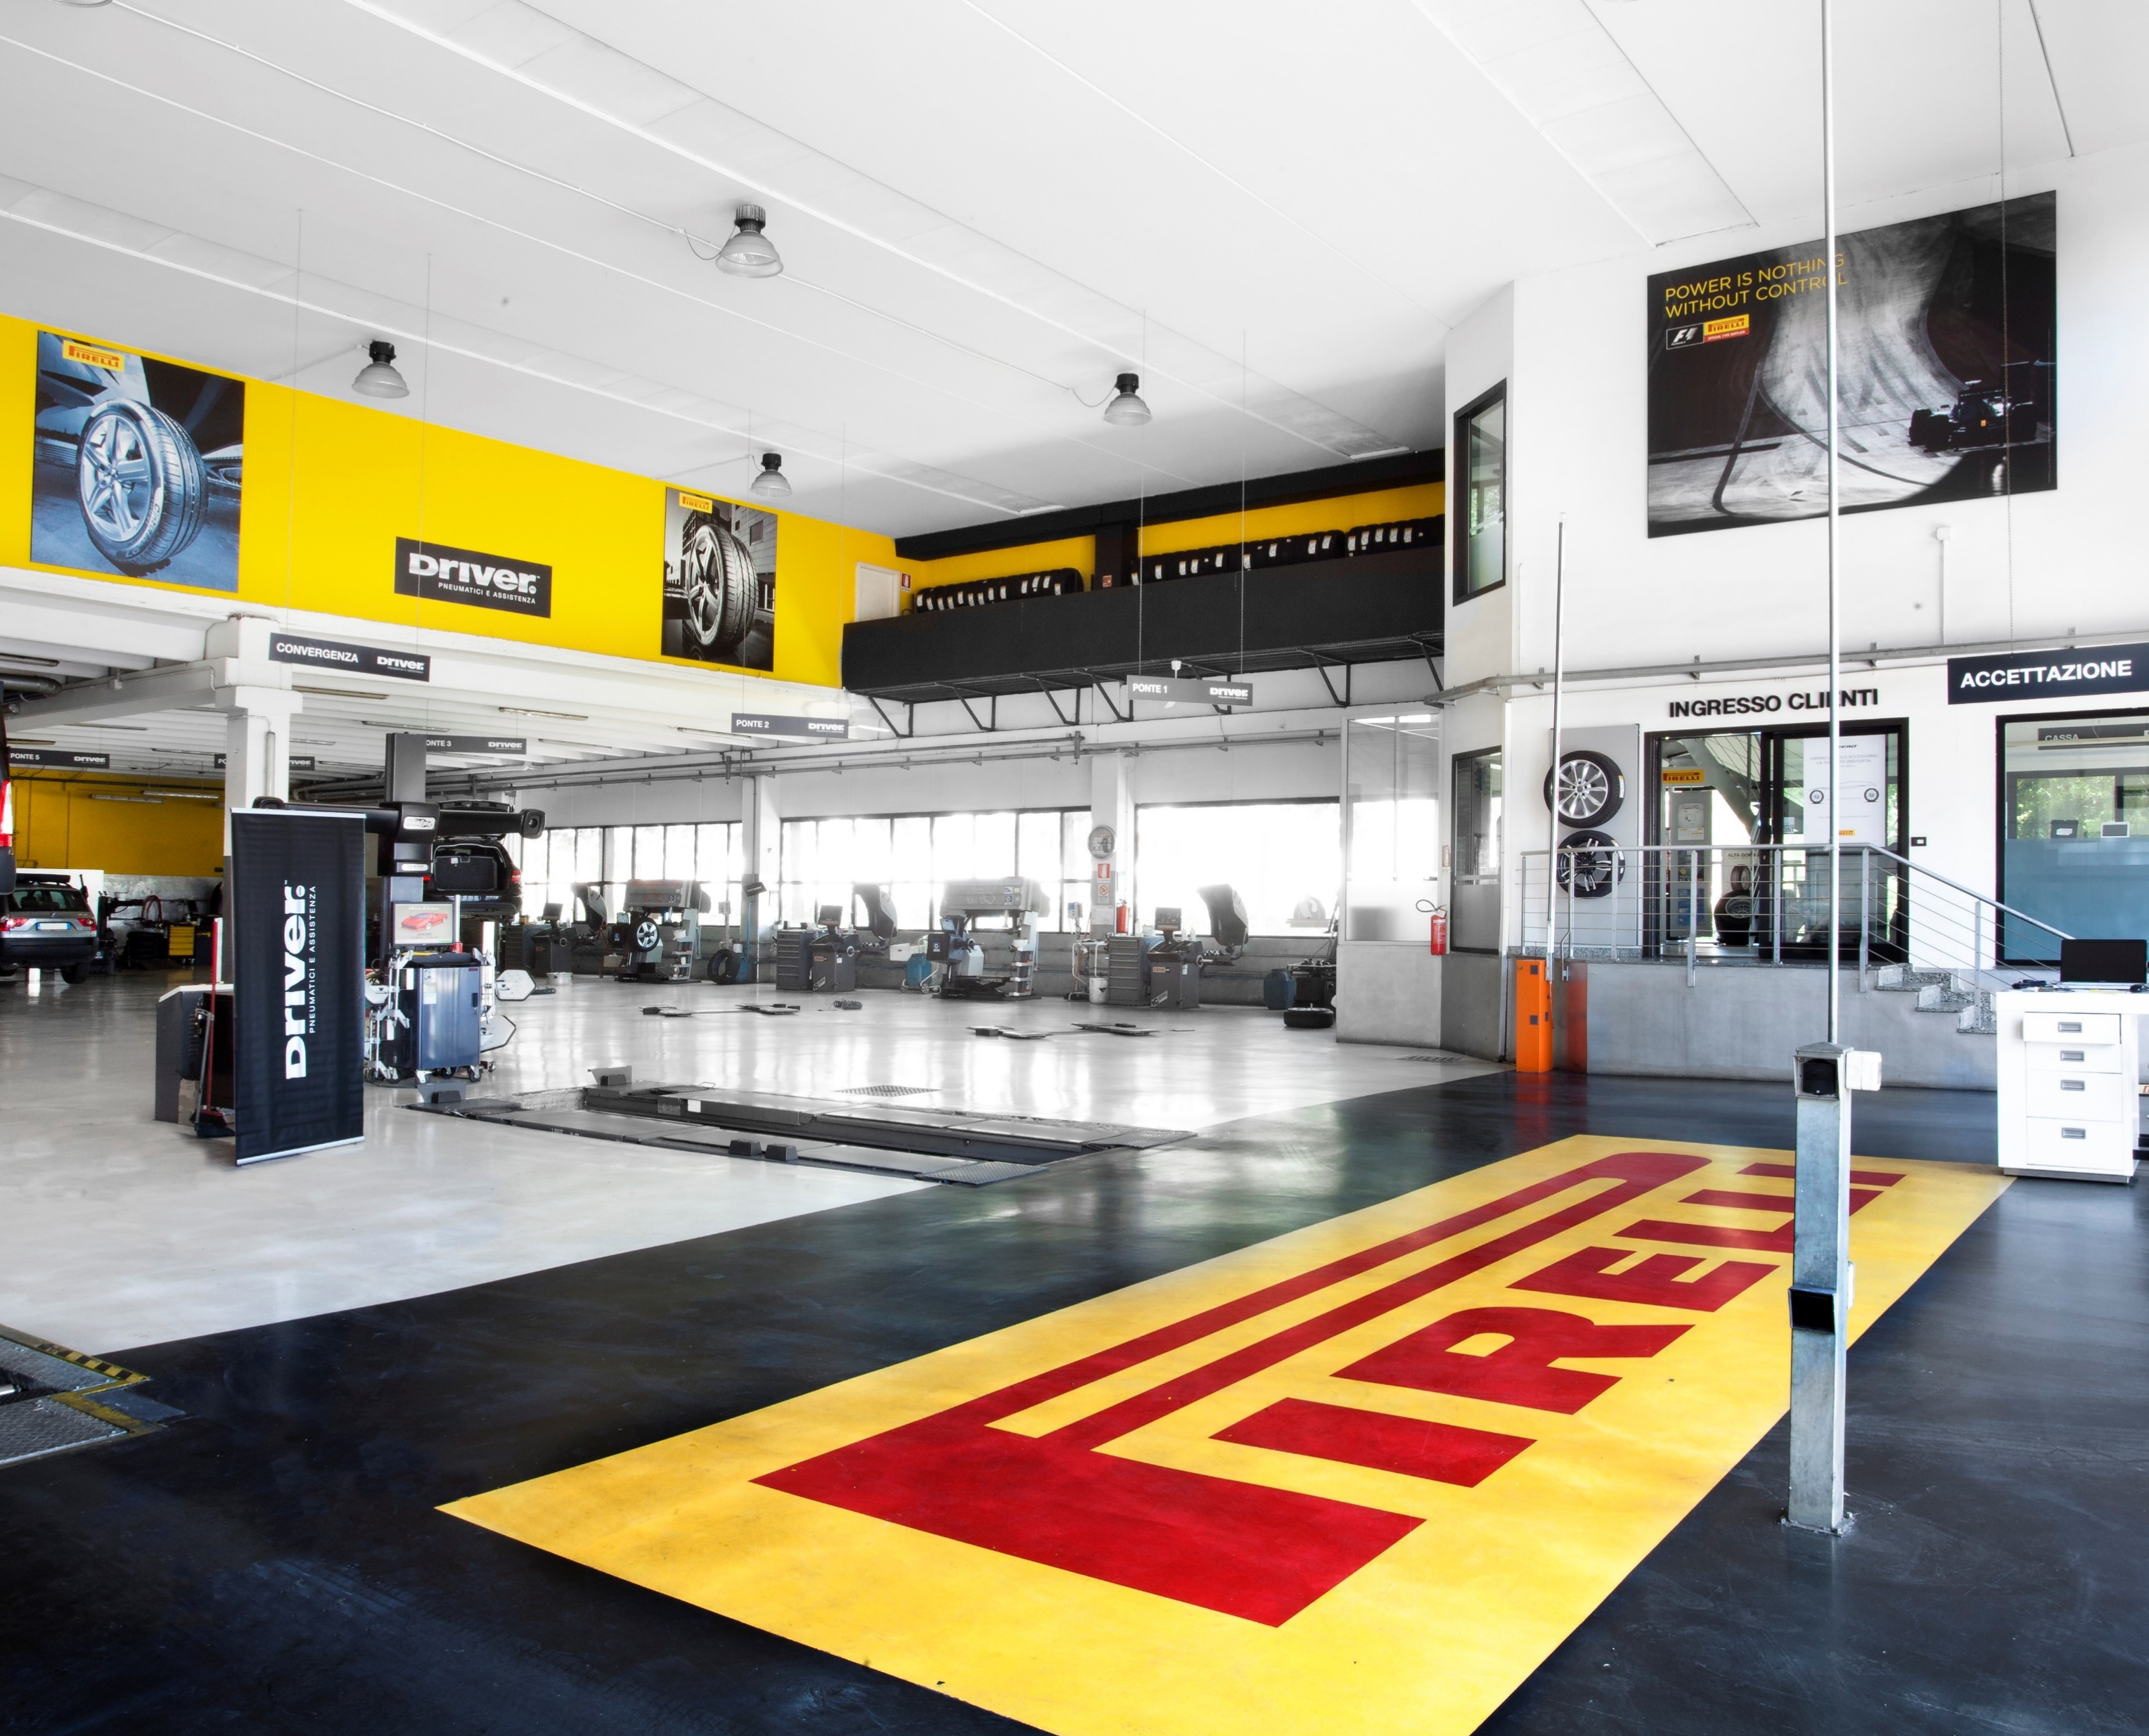

Engaging with our customers on sustainability journey
STRENGTHENING OUR GLOBAL VALUE CHAIN
SUSTAINABILITY
MEETINGS
SUSTAINABILITY
NARRATIVE ON
B2B CHANNEL
SUSTAINABILITY
JOURNEY PROGRAM
LINKING THE BRAND WITH SUSTAINABILITY VALUES
Various Trade meeting in EU focused on Sustainability topics
2024 Training activity on Pirelli Sustainability Journey
Embedding sustainability models into retail practices
Conveying the value of sustainability within purchasing experience

Slide 25
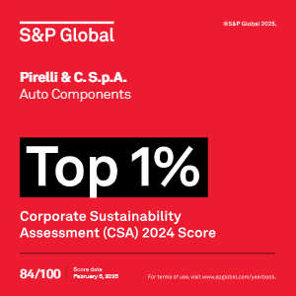
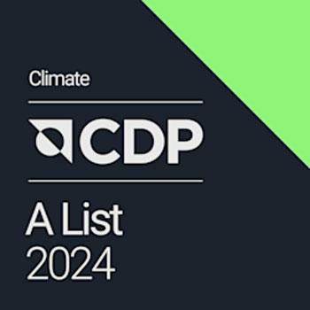

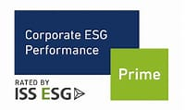
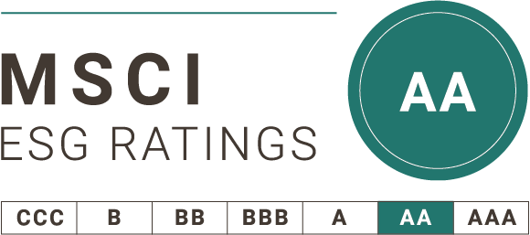
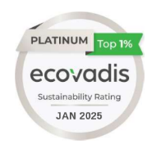
ESG Indices: a globally acknowledged sustainability leadership
Update @ 21/07/25
Major rankings
Last update
Score
Positioning in the reference sector
Dow Jones Sustainability Index
Top score Auto Components
and Automotive sector
2024
84
2025
TOP 1% ESG
The only tyre maker in Top1%
2025
A
A LIST – Max score
2025
A
A LIST– Max score
Supplier Engagement Leaders
2024
B
Prime status - Top score Auto Components
2024
AA
AA - ESG Leader Category
SUSTAINALYTICS
2025
8.3
Top score Tyre industry (Negligible risk);
Awarded Industry ESG Top Rating
2025
82
Platinum - Top 1%
Source: third party official rankings – udpated 15 July 2025

Slide 26
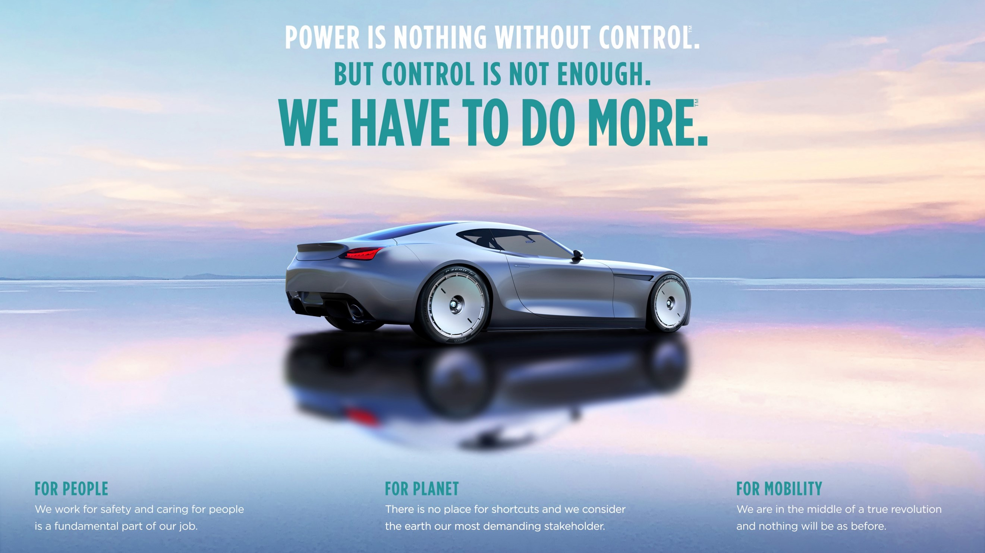
Copertina chiusura

